Slide 1
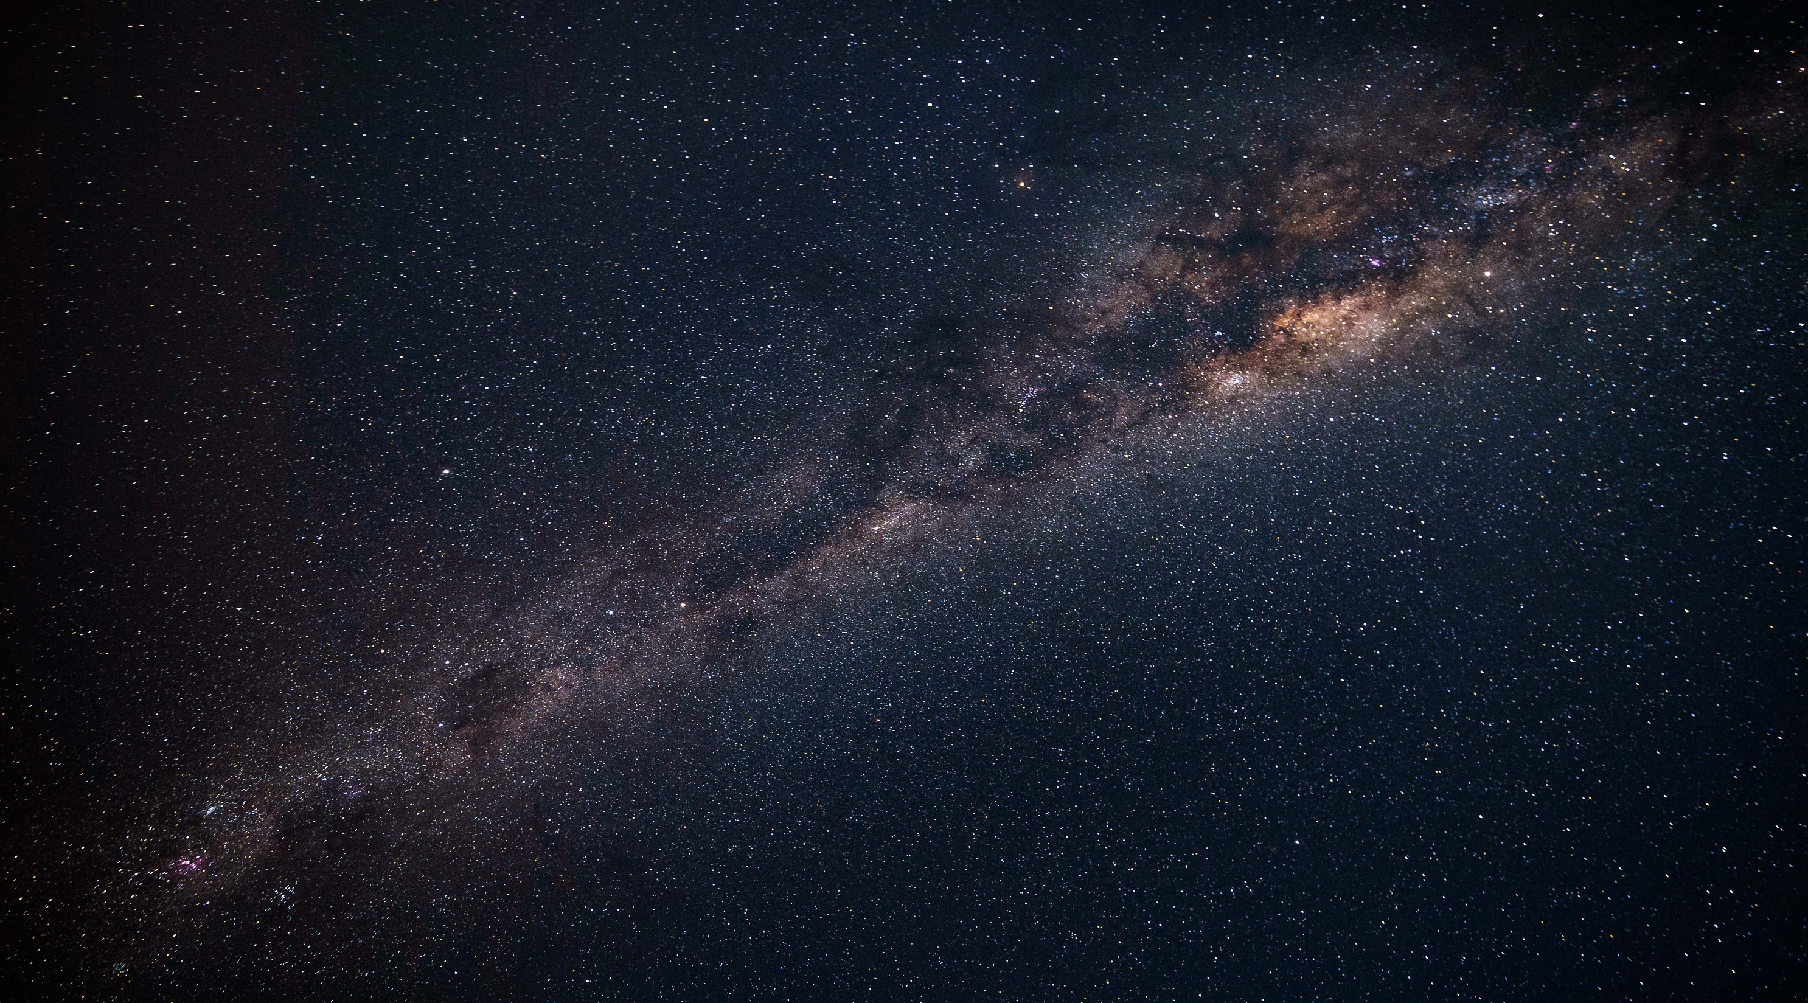

Sky Guide / Tracker

Slide 2

Introduction

Slide 3
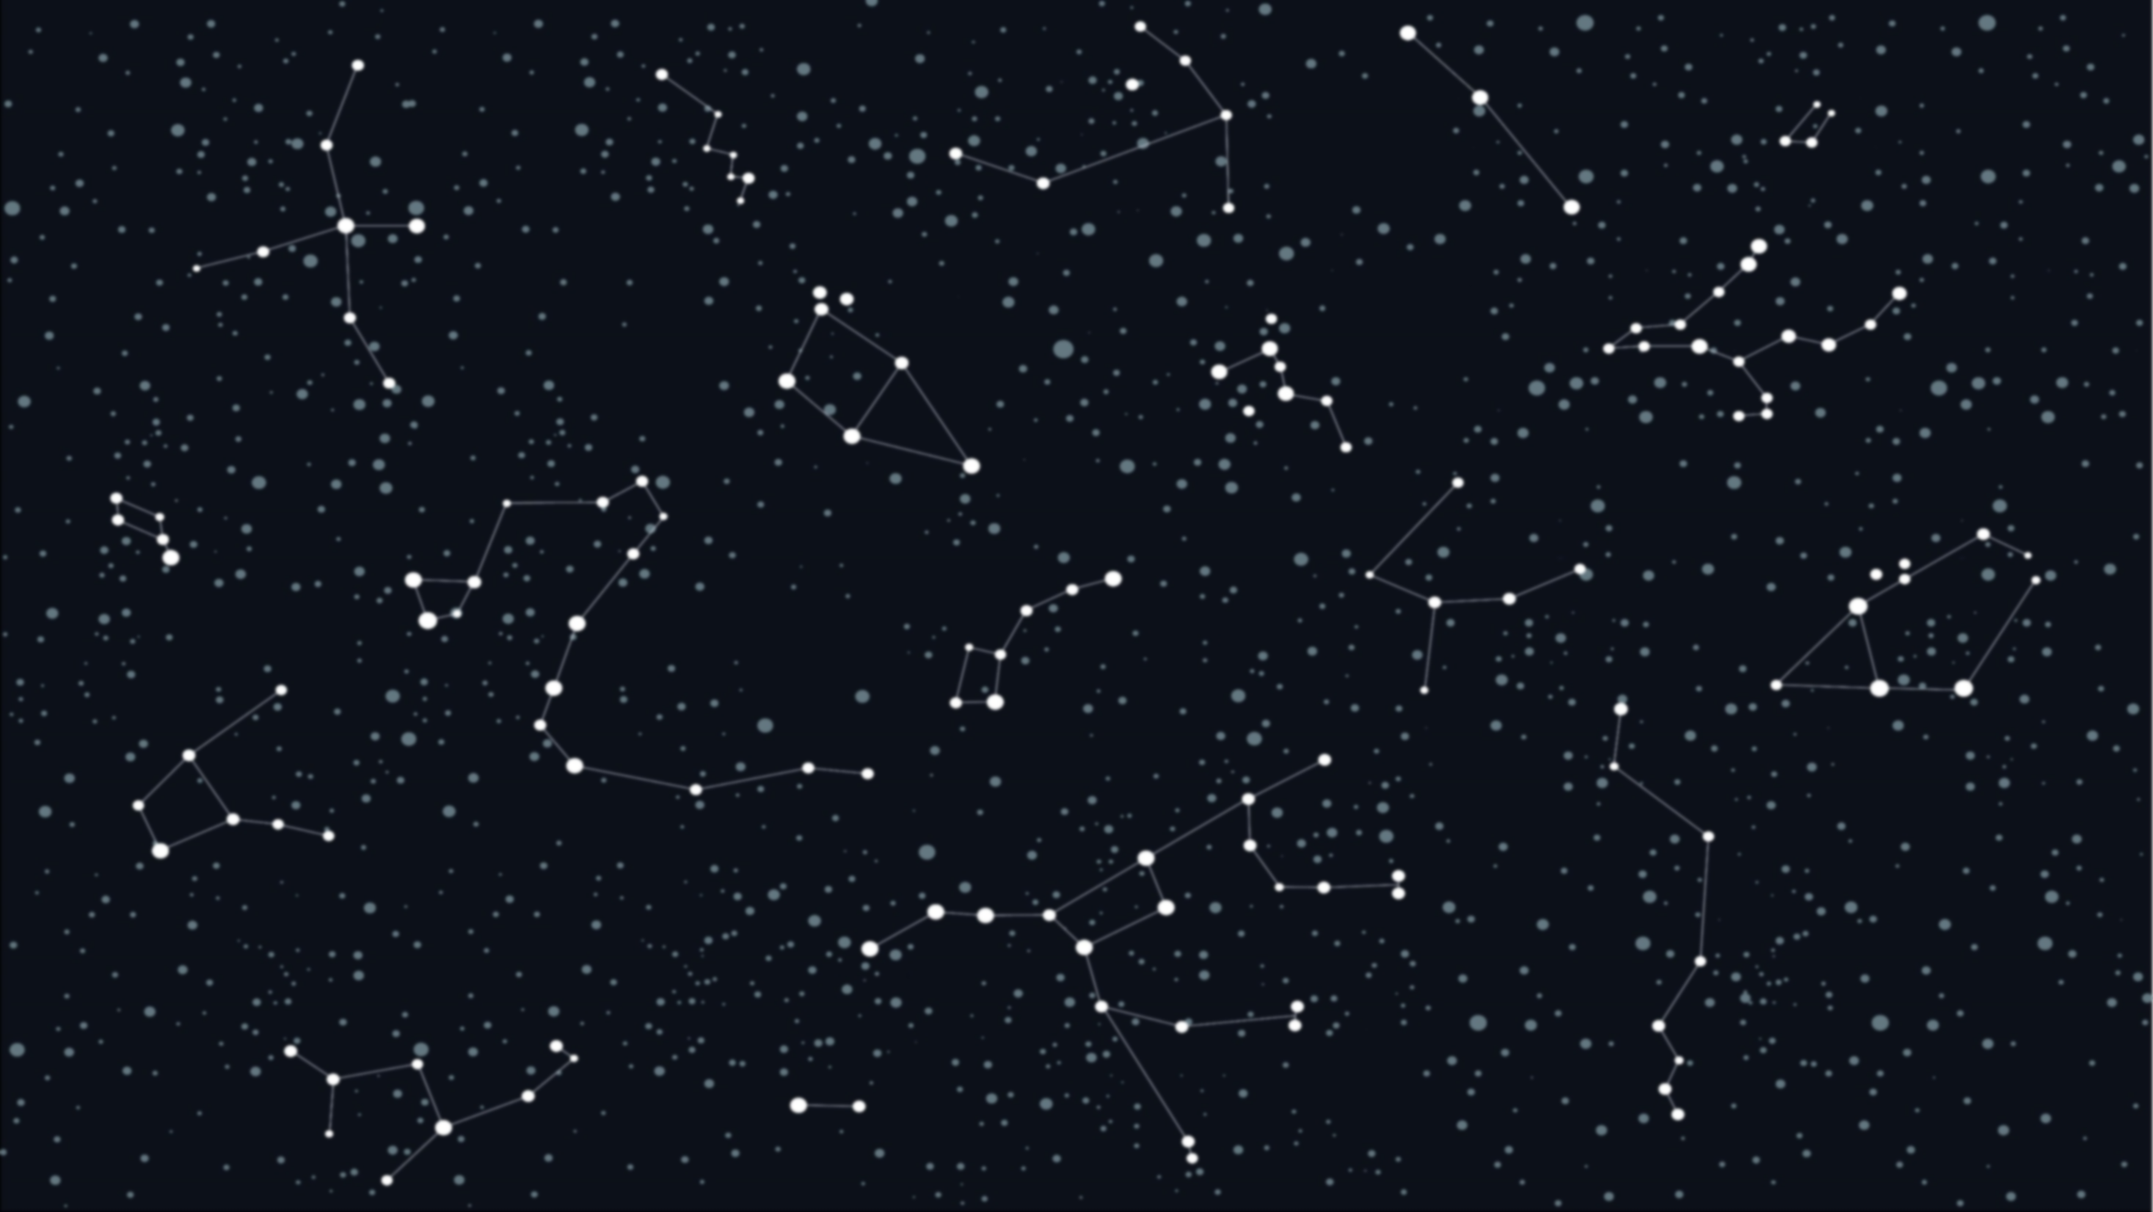
The importance of understanding
the night sky

Slide 4

How to find and track a celestial object?

Slide 5
Finding a celestial object
The challenge of finding a celestial object in the night sky.
All the celestial objects seems to look the same under the darkness of the night.
Throw-out history, humans have came up with many coordinate systems to help with navigating the sky.

Slide 6
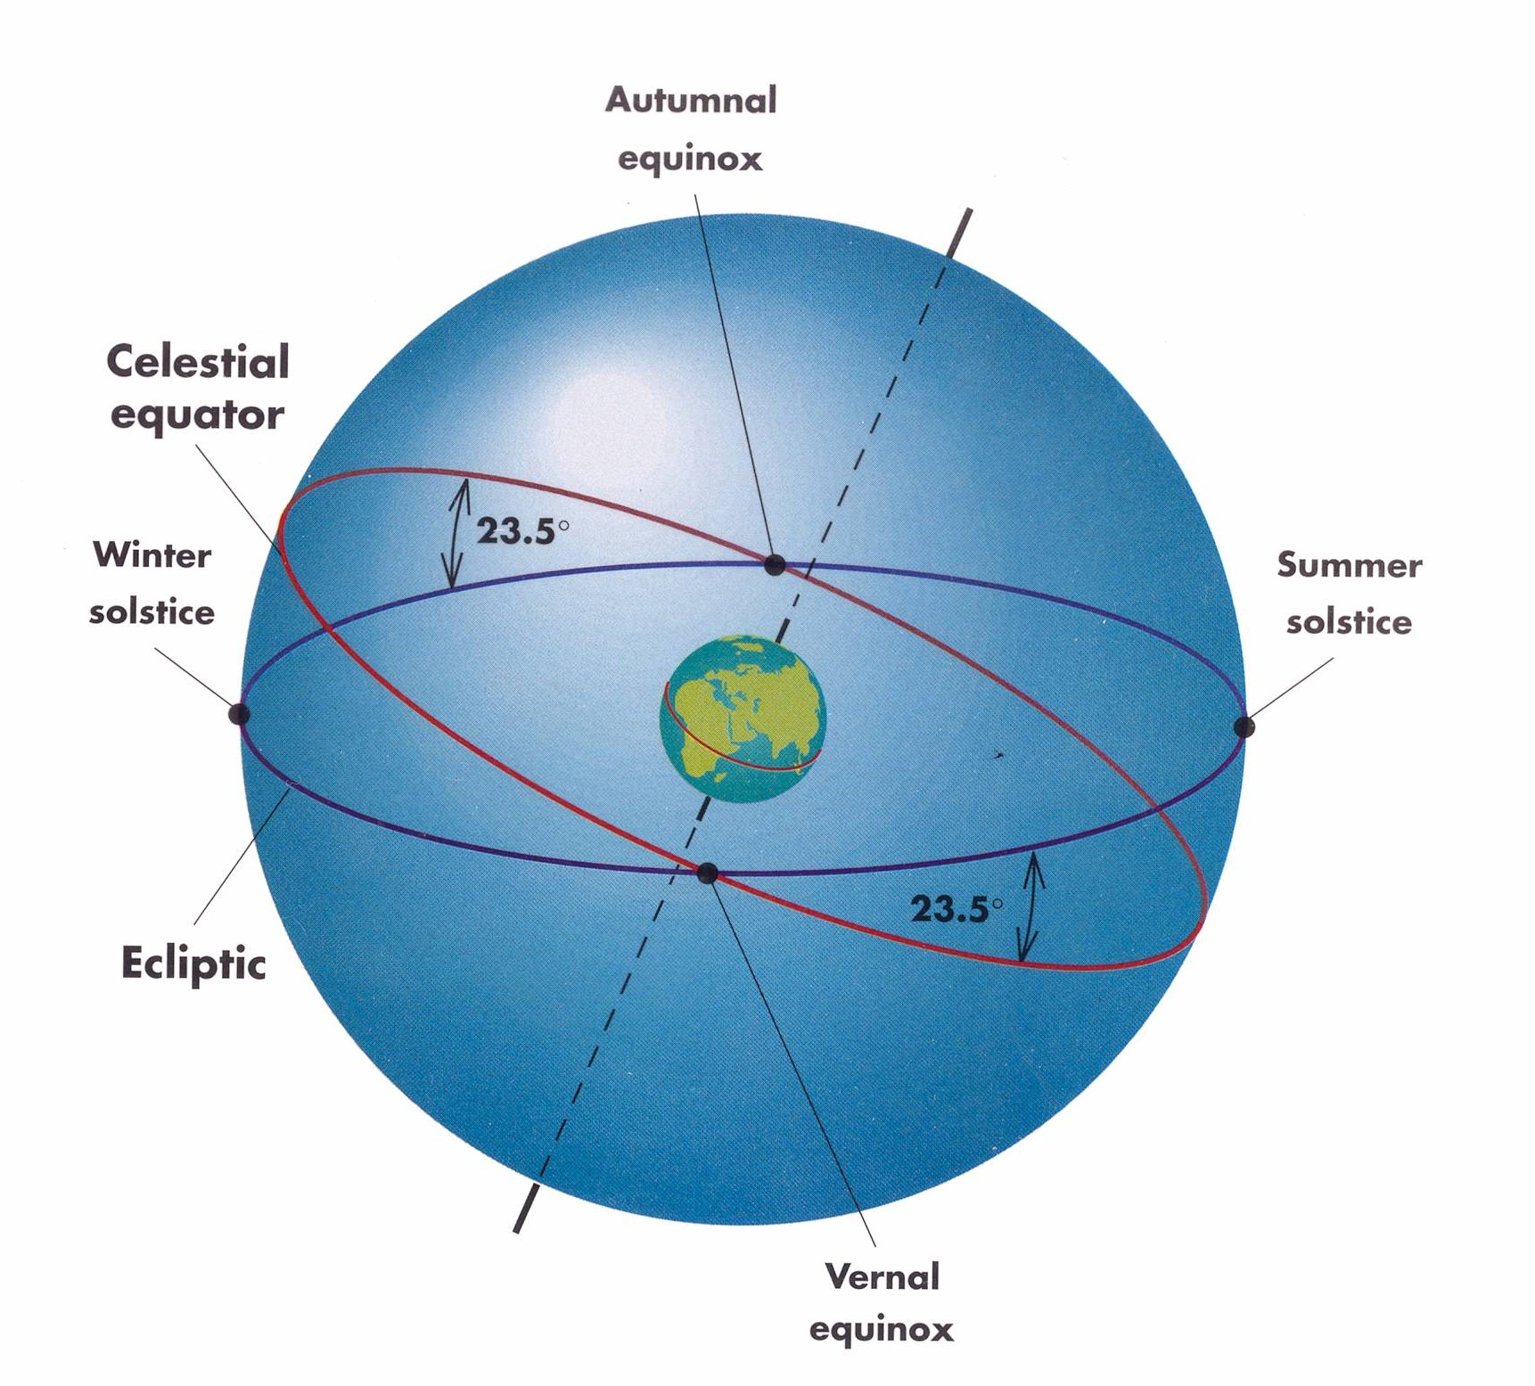
Terminologies
Celestial Sphere.
Celestial Sphere is an abstract sphere that has an infinite radius and shares the same center with the Earth.
3d visualization: https://javalab.org/en/celestial_equator_and_the_ecliptic_en/

Slide 7
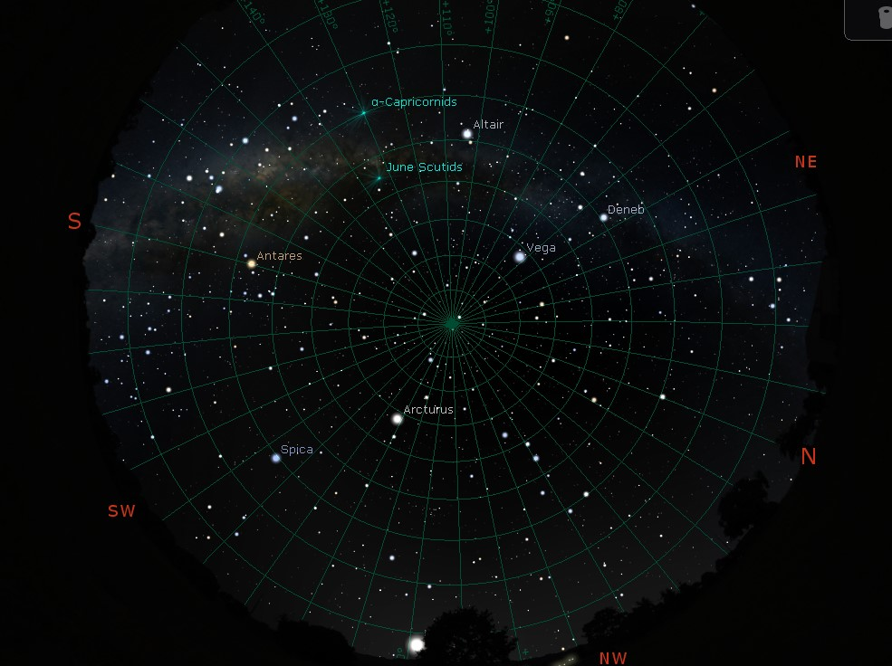
Standing outside on a clear moonless night far from city lights, it is easy to imagine that one is at the center of such a sphere and that the stars and planets are attached to its inside surface.

Slide 8
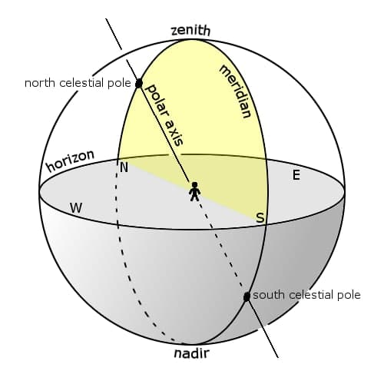
Terminology Cont.
2. Meridian
The great circle passing through the celestial poles, as well as the zenith and nadir of an observer's location

Slide 9
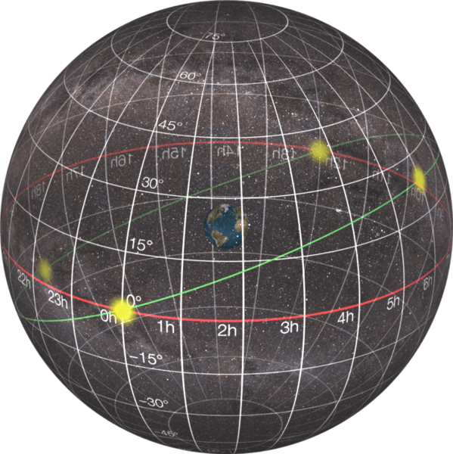
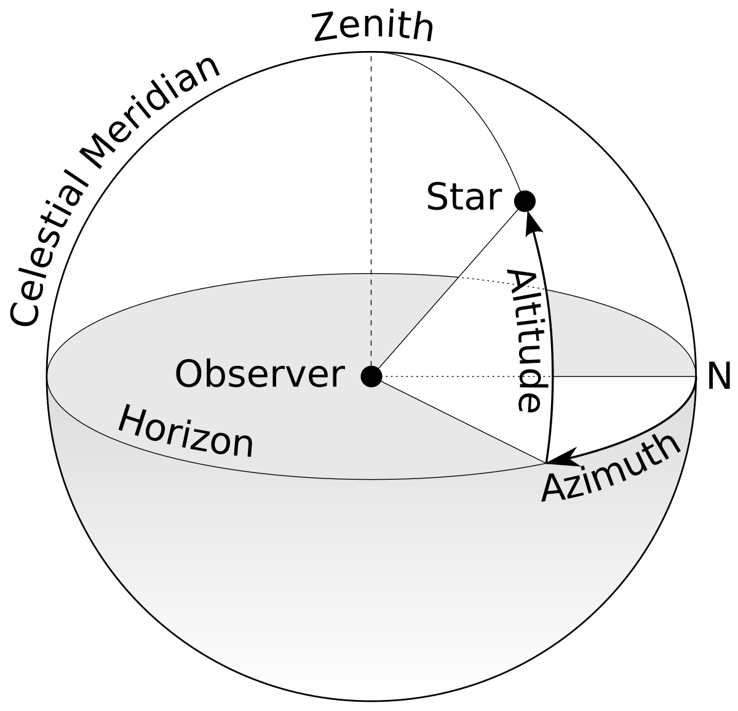
Celestial Coordinate Systems
There are many celestial coordinate systems, in this project we focus on: The equatorial coordinate system
Equatorial system
Horizontal System

Slide 10
Equatorial Coordinate System
The system is similar to the system of latitudes and longitudes used for the locations of objects on the surface of the Earth. Right ascension is analogous to longitude. Declination is analogous to latitude.

Slide 11
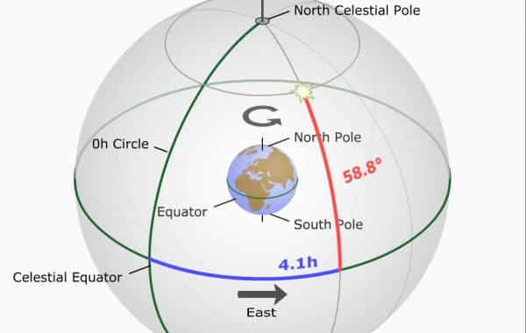
Equatorial Coordinate System Cont.
Example of finding a star at RA = 4.1h and Dec = 58.8 degree
3d visualization: https://javalab.org/en/equatorial_coordinate_system_en/

Slide 12
Finding RA Challenge
Finding declination of a celestial object is easy.
However, this is not the same with finding right ascension.
This Introduces us to the concept of Local Sidereal Time (LST).

Slide 13

Local Sidereal Time (LST)
Astronomers use Sidereal Time to measure the movement of the celestial sphere.
Local sidereal time (LST) is the sidereal time where the observer’s located, it is equal to the RA of any celestial object that is transiting the observer’s meridian.
Reference: Astronomical algorithms 2nd edition” by Jean Meeus, chapter 12.
Notes:
FAR

Slide 14


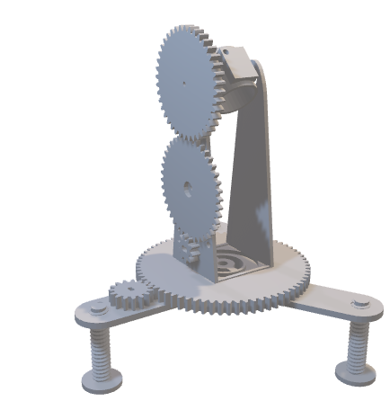
Our Approach
Sky Guide Database
Desktop Application
Mount

Slide 15



Sky Guide Database

Slide 16
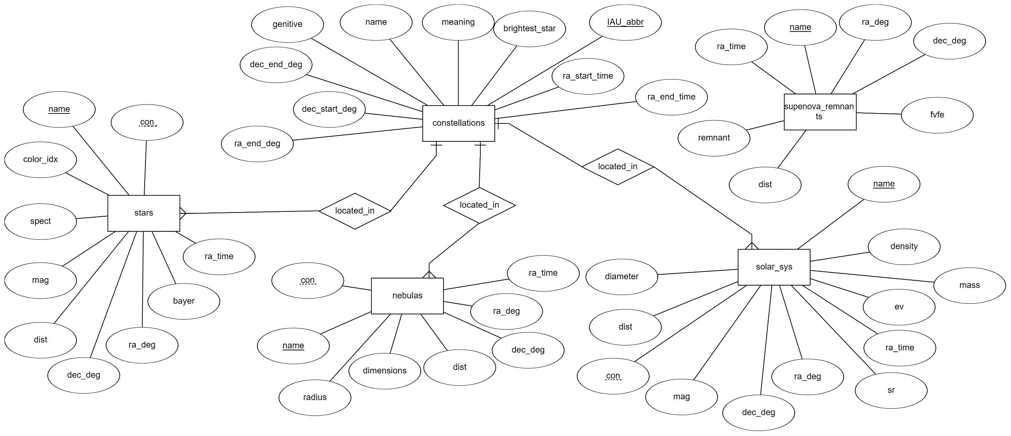
Sky Guide Database Cont.

Slide 17
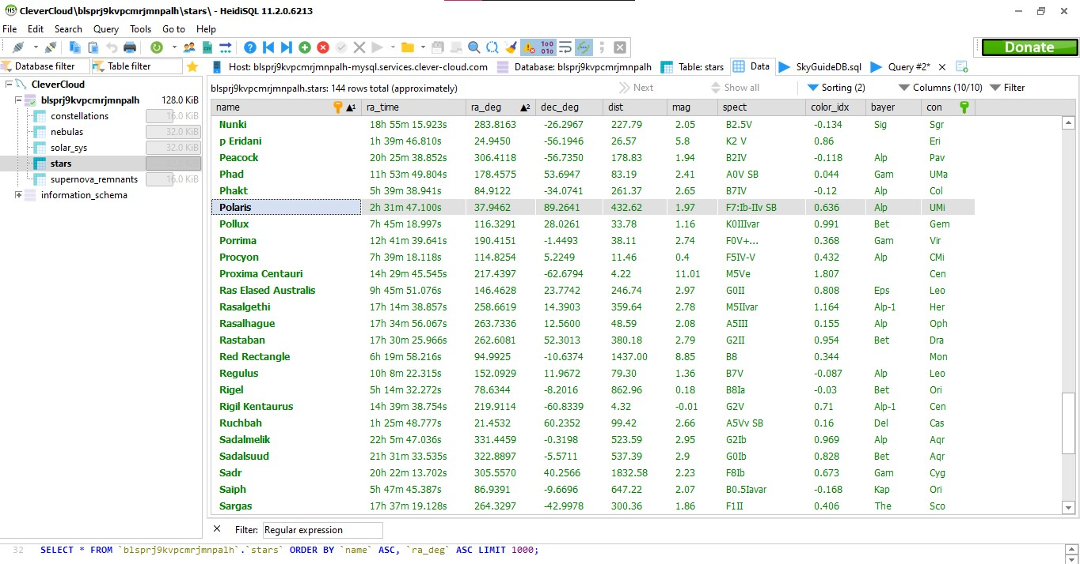
Sky Guide Database Cont.

Slide 18


Sky Guide Database Cont.
Still, there was a problem in the solar system table.

Slide 19

Desktop Application
1. Application Backend

Slide 20
Desktop Application Cont.
Application
Layer
Business
Layer
Backend layers:
Data Access
Layer

Slide 21
Desktop Application Cont.
Data access layer:
Data Access
Layer

Slide 22
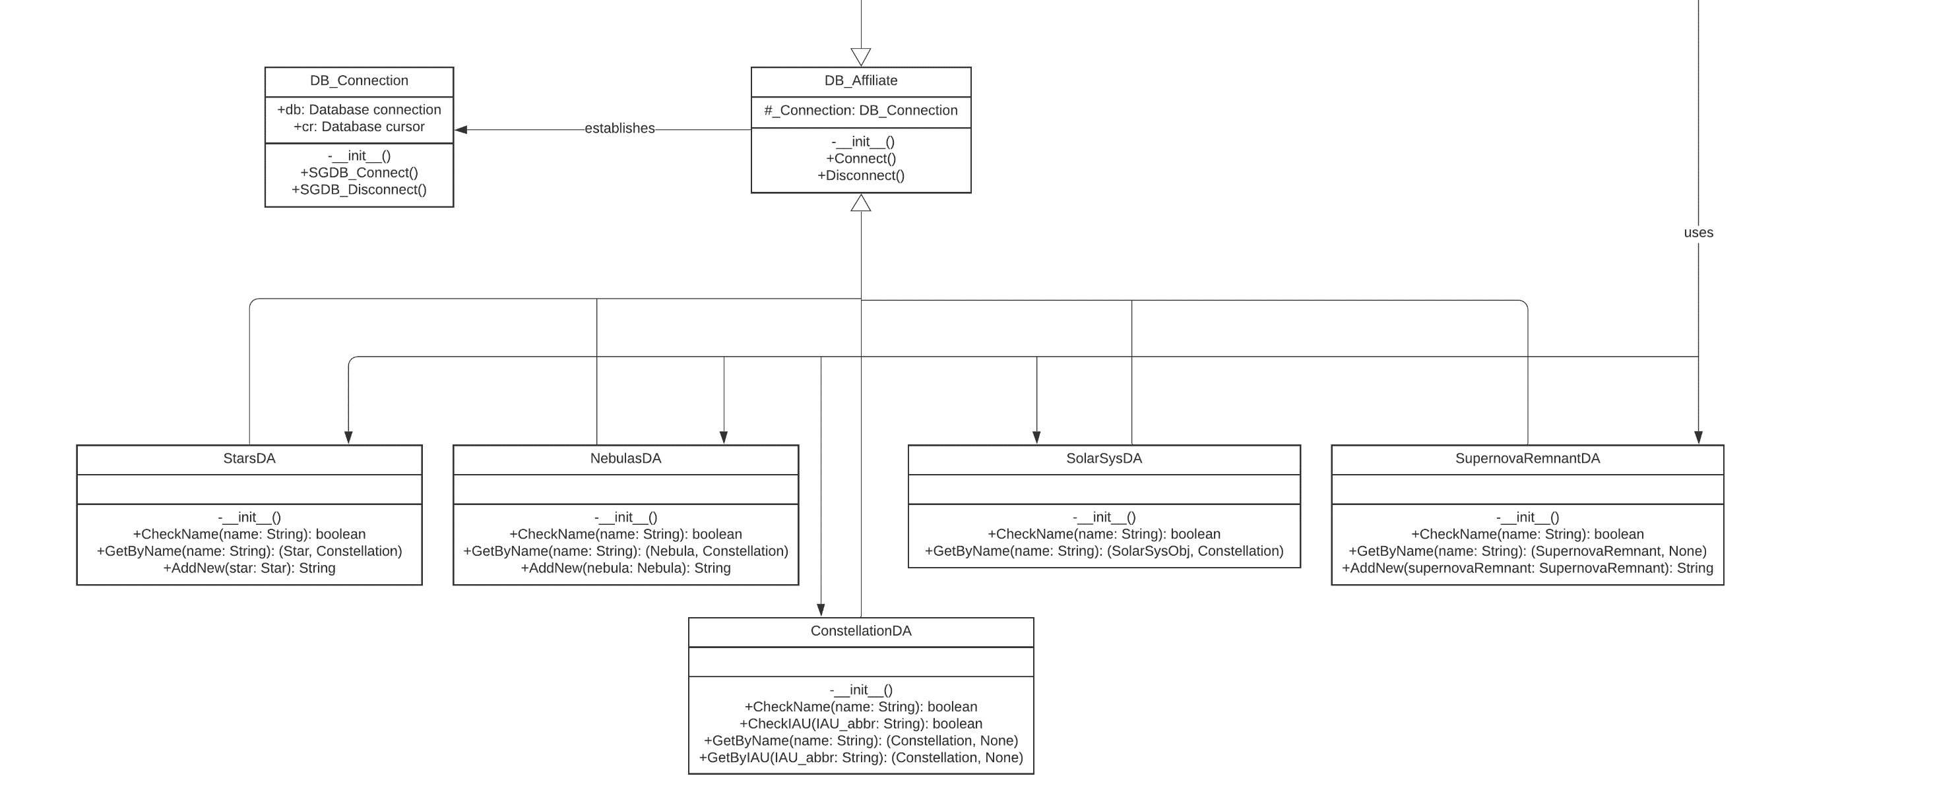
Desktop Application Cont.
Data access layer UML:

Slide 23
Desktop Application Cont.
Business layer:
Business
Layer

Slide 24
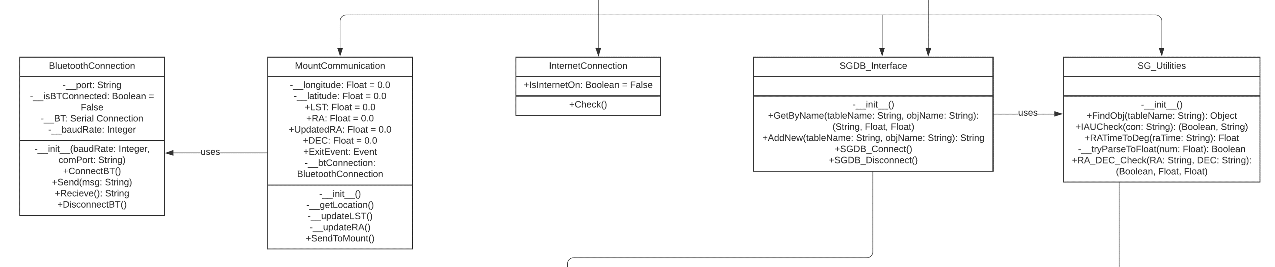
Desktop Application Cont.
Business Layer UML:

Slide 25
Desktop Application Cont.
Application layer:
Application
Layer
Frontend

Slide 26
Desktop Application Cont.
Application Threads:
Main Thread
Internet check thread
Mount communication thread

Slide 27

Desktop Application Cont.
2. Application frontend.
The Frontend will enable the user to perform the following actions on Sky Guide database:
- Search for a celestial object by name.
- Explore specific coordinates.
- Add a new celestial object to the database.

Slide 28
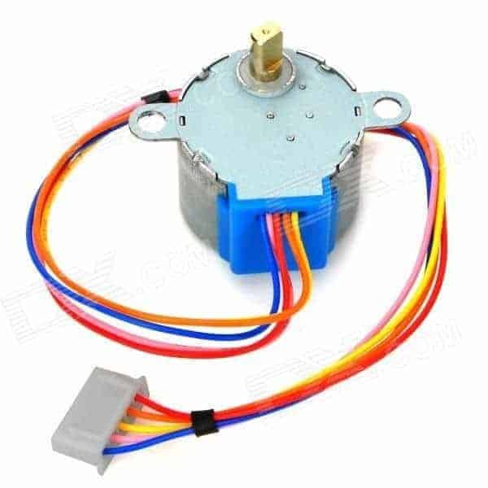
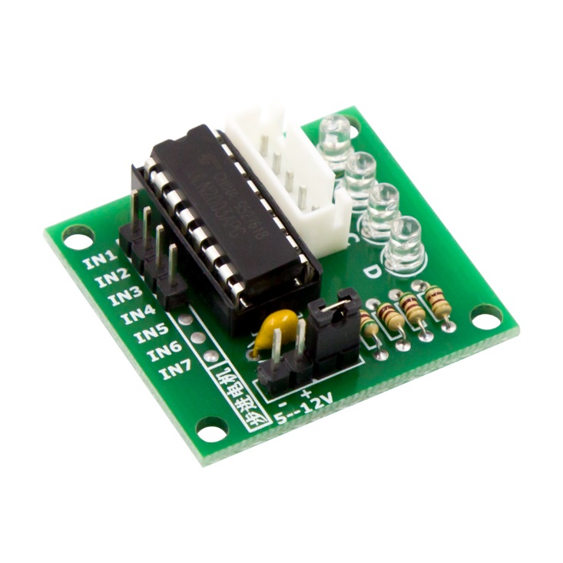
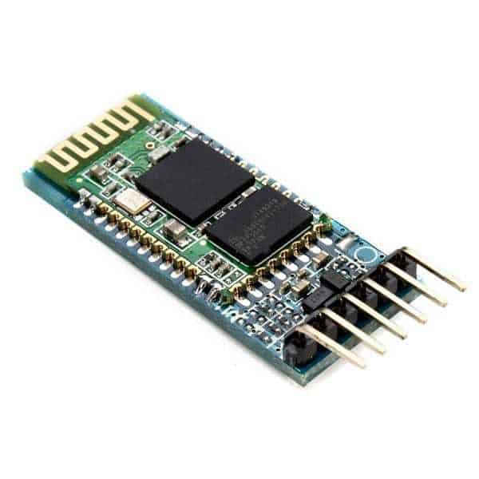
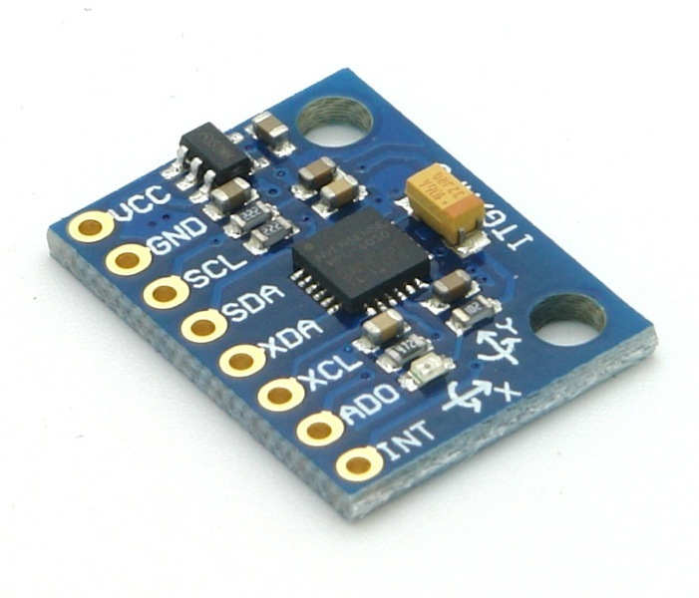
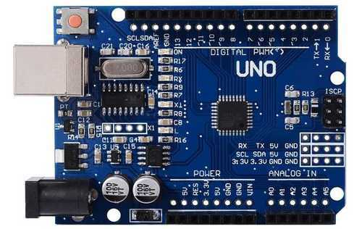
Physical Device
Used components:
28BYJ-48 ULN2003
HC-05 MPU6050 Arduino Uno

Slide 29
Physical Device Cont.
Firmware logic: Master
Get gyro readings
Receive angles
Compare
Send CS to slave

Slide 30
Physical Device Cont.
Firmware logic: Slave
Receive CS from master
Control Steppers

Slide 31
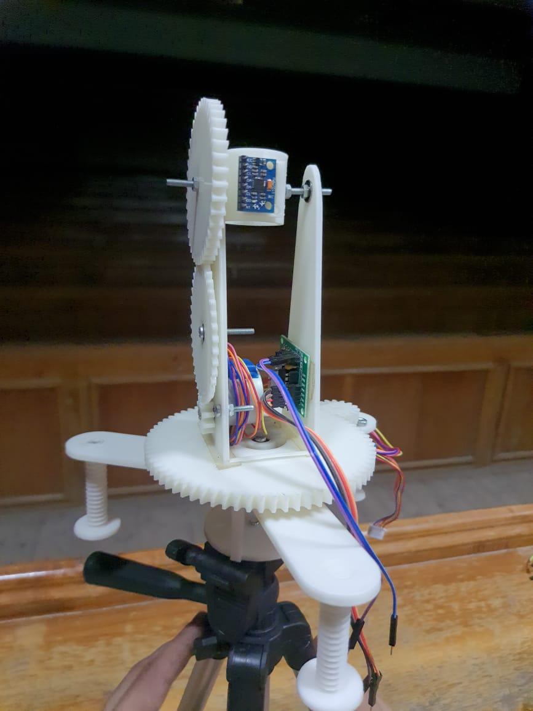
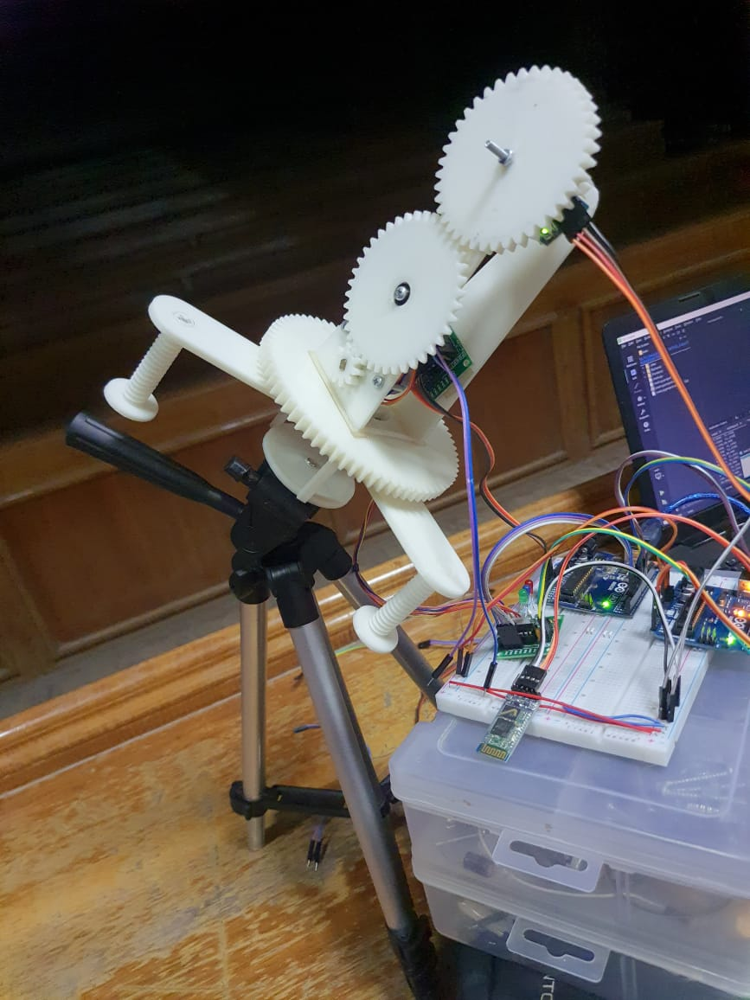
Physical Device Cont.
Physical Body:

Slide 32
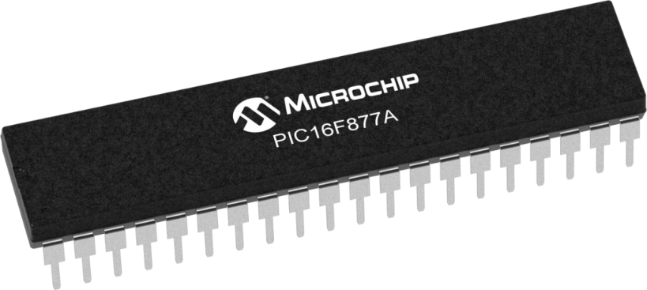
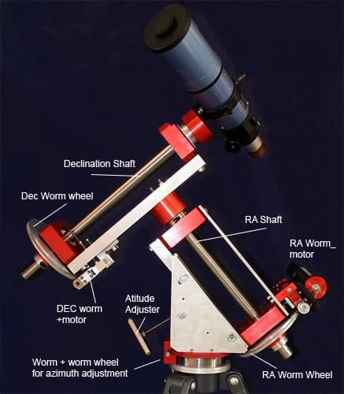
What’s Next?
Implement the hardware part using a different microcontroller other than Arduino.
Build a mount that will be able to carry a telescope or a camera and make them point at the sky.
Substitute the Bluetooth connection with a more robust wireless connection.
Add more features to Sky Guide desktop application.

Slide 33
Thank You!

